Slide 1



1
MECHA
Manufacturing E-Checksheet Application
Anang Ma’ruf
Bani Salam
DM2260926
250-Maintenance
DM2260929
510-Stamping
Back End Developer
Front End Developer

Slide 2














Digitizing checksheet material production lot control according to user needs
DETAIL SYSTEM
MECHA
2
Easy for NG Products Tracking and Data Input by Digital Material Lot Control System
CURRENT CONDITION
STANDARD
PROPOSAL
PURPOSE
Way Of Thinking
Efficient operation
and
Good Traceability
Wrong Data
Input Time
All lines have the same process to input lot number
Tracing the history on stacked papers
need
up to 20 seconds for 6 items
Some lines have different ways of inputting data
Digitalize the material lot control check sheet (input, process, data record)
Caused by human error.
Tracing the
History
Not
standardized
=
Simple and
Easy To Input
data and search History
Input lot number at the same time when insert material to machine
Make a checksheet that can be used by every line.
Line 1 input the data directly
Line 2 drawn up at the end of the shift.
GOALS
TARGET
TIMELINE
ACTIVITY
Grouping and filtering to make it easy to trace the lot number
0 data fault risk by auto input of several data
SPEC ANALYSIS
TRIAL AND IMPLEMENTATION
Unfinished
Longer programming time, unsupported device
10-20 July
31 July-2 August
Digitizing checksheet material lot control checksheet according to user needs
Reduce time for data input (2 items)
Standardization process of material lot control
DEVELOPMENT
PRESENTATION
10 July - 1 August
27 July-4 August
MAKE EFFECTIVE E-CHECK SHEET TO SOLVE USER’S PROBLEM AND BASED ON STANDARD
All lines have the same process to input lot number

Slide 3











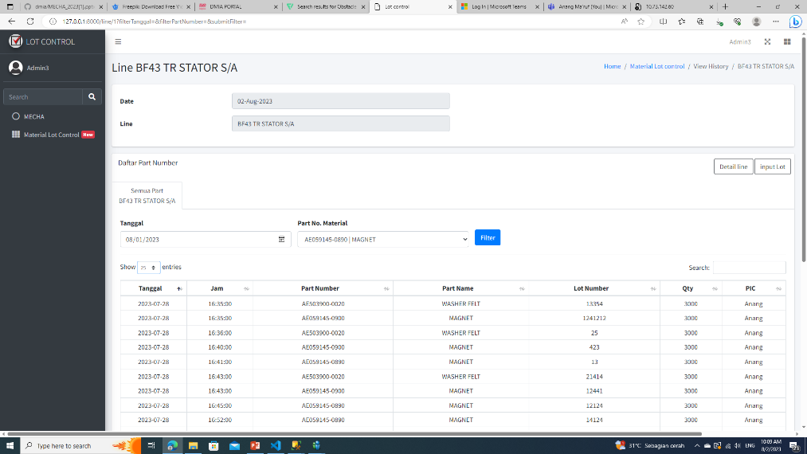









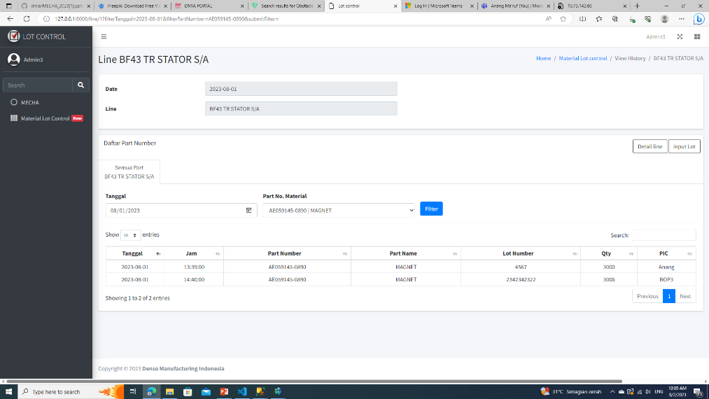
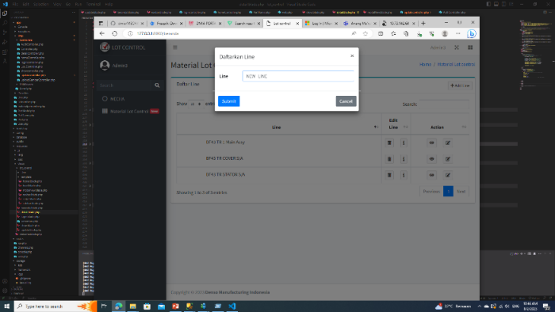

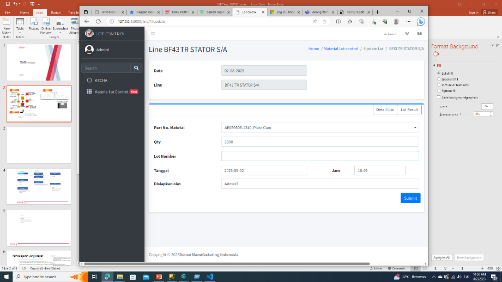
DETAIL SYSTEM
3
SYSTEM COMPARISON
BEFORE
AFTER
STRUGGLE
PREPARATION
PREPARATION
IDEAL CONDITION
Input by scan to get part number & lot number
}
Prepare Check sheet, distribute, pen.
DIGITAL
Provide a connected device to server
1
INPUT
ACTUAL CONDITION
INPUT
Up to 6 items. Index, Date, Hour, Lot Number, QTY, PIC
INPUT
Most Lot numbers don’t have QR code
QR doesn’t contain Lot number
3 items
(Part number, Lot Number, Hour)
PROBLEM
Make a summary that has same format with paper check sheet
TRACKING
RECORD
2
=
Searching on stacked papers
One date separated on different papers
RECORD
PAPER
collected in one place.
Filter and Search to reduce searching time.
Some Lines have different summary because different check sheet formats
FEATURES
STRUGGLE
AUTO INPUT DATA
TOOLS
2
some lines has different format.
1
CAN BE USED BY
ALL LINES
some lines has different format.
Make a website that compatible with all lines
Make a website that compatible with all lines
FILTER SEARCHING
PROBLEM
3
MAKE A CHECKSHEET THAT COMPATIBLE FOR ALL LINES

Slide 4
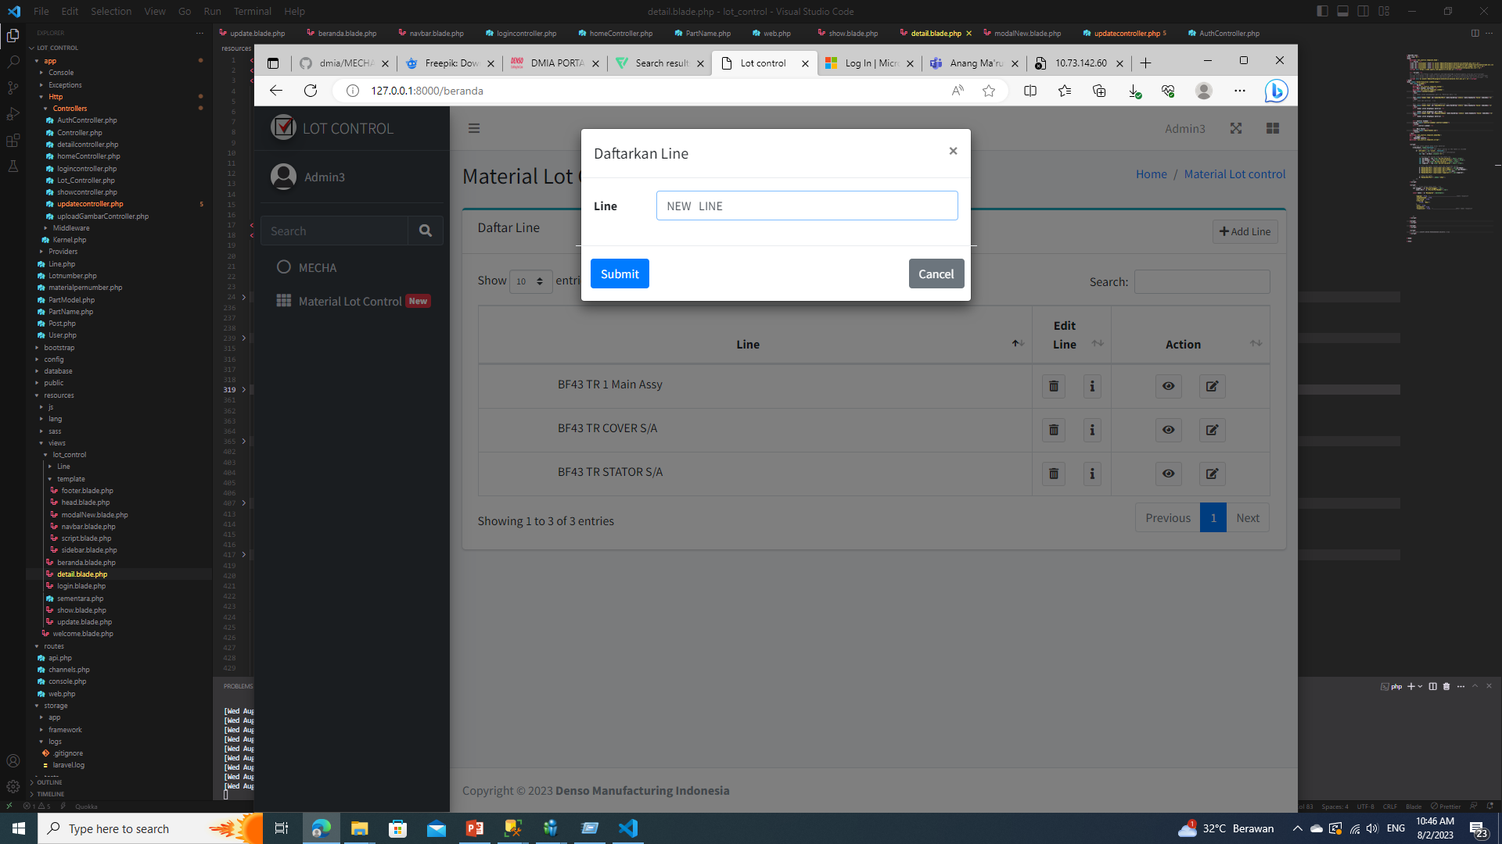
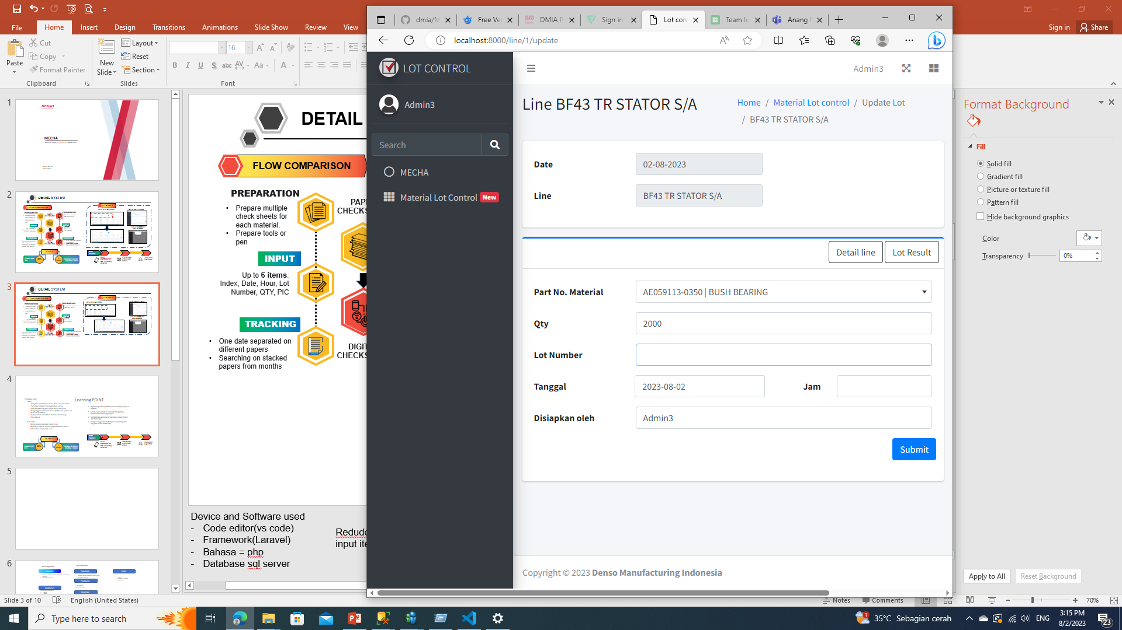

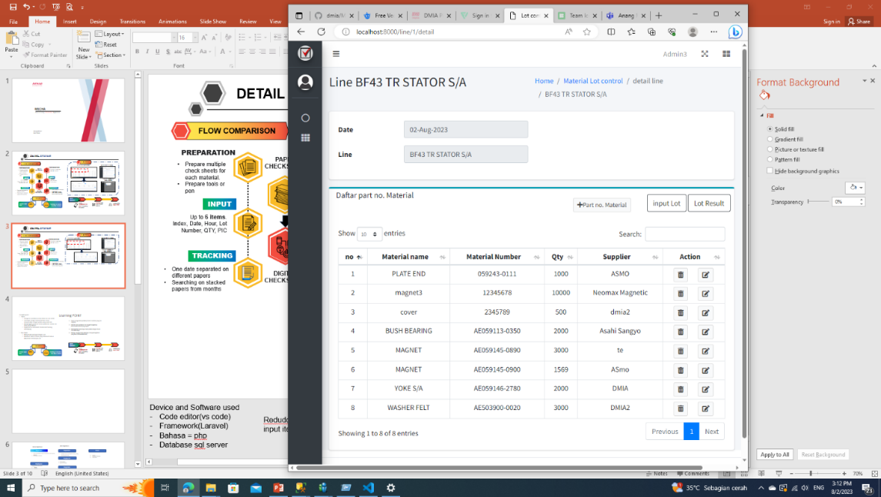
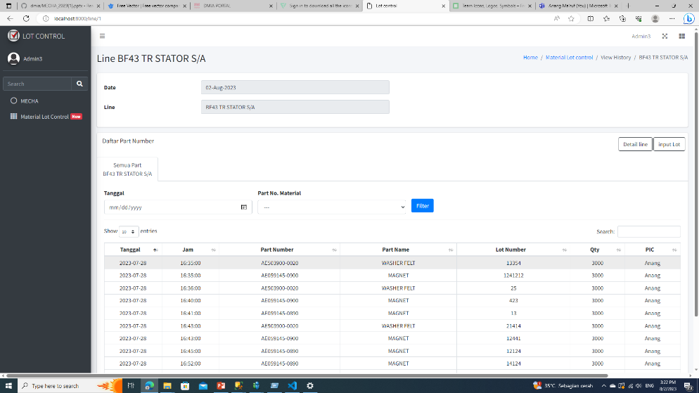


Tracking Lot number less than 1 minute
RESULT
4
INPUT LOT FORM
LOT RESULT
SETTING PAGE
WEB RESULT
*Input lot by typing
*Setting page only available for admin
NEXT PLAN
50%
RESULT
6
3
ITEMS
INPUT SYSTEM
TYPING
IMPLEMENTATION
STANDARD FLOW
BEFORE
AFTER
Reduce
TIME
14 s
Need a Smartphone device for BOP for input lot number directly
Bop carry a smartphone
Insert Materials into Machine
20 s
60%
DEVELOPMENT
DATA ACCURACY
95 %
Failure chance = error typing
Develop scan system for faster data input
Done
Time needed is
less than
Will be continued by BF43 Team
Input Lot Number
NEXT
PROJECT
LOT TRACING
1
minute
LOT TRACING TIME < 1 minute & REDUCE 50% INPUT ITEMS
AFTER

Slide 5





analyze the current problems and conditions that are happening to the user
LEARNING POINT
5
Struggling point
Teknis
mengatur autentikasi untuk admin dan non admin
Tantangan dengan framework baru untuk menyesuaikan dengan system yang sudah ada
Mengunggah system ke server, perbedaan system dan akses yang terbatas
Implementasi terhambat. Environment kurang mendukung
Non teknis
Menyamakan presepsi dengan user
Membuat sebuah Sistem yang memenuhi semua kebutuhan dari banyak user
Analyze the problems and current conditions that are happening to the user
Improve communication skill with sub coordinate and user
Make an improvement plan or concept correctly
Dapat menganalisis problem/current condition yang ada di genba.
Membut plan perbaikan dan langkah langkahnya berdasarkan kondisi yang terjadi
Meningkatkan kemampuan komunikasi dengan atasan dan rekan kerja.
Mampu menggunakan beberapa tools pemrograman yang baru (frameworklaravel)
Be able to use the new programming tool, Laravel and its system
CREATE AN IDEAL PLAN FOR A PROJECT
Membuat sebuah website Checksheet yang sangat sesuai dengan ekspetasi semua calon user.
Penggunaan Bahasa pemrograman Laravel dimana kita harus menyesuaikan dengan Vendor.
Menyamakan presepsi antara kita dengan user
Request user yang melebihi kapasitas kami.
Komunikasi yang masih kurang antara User dengan kami ketika mengumpulkan data.
Problem yang tetap ada walaupun sudah terimplementasi.
Saat mau mereview project kepada user butuh akses tambahan karena security system.
Banyak web yang tidak bisa diAkses untuk membantu membuat website.
Kesulitan :
PT. DENSO MANUFACTURING INDONESIA
System Development
@ DENSO CORPORATION All Rights Reserved.
Can analyze problems/current conditions in genba.
Make an improvement plan and steps based on the conditions
Improve communication skills with superiors and colleagues.
Be ableble to use some new programming tools (laravel framework)

